Slide 1
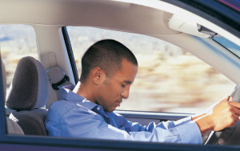
Driver Drowsiness Detection System

Slide 2
Why do we need this project?
Increasing number of accidents on today’s roads
Car accident is the major cause of death in which around 1.3 million people die every year.
Majority of these accidents are caused because of distraction or the drowsiness of driver.
The proof has been verified by many researchers that have demonstrated ties between driver drowsiness and road accidents
To prevent such accidents we propose a system which alerts the driver if the driver gets distracted or feels drowsy.

Slide 3
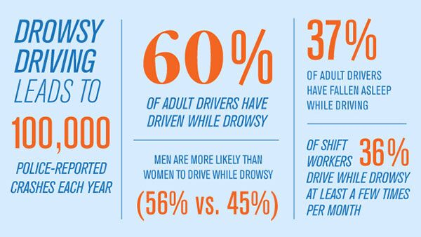

Slide 4
Research shows that driver fatigue and drowsiness is one of the major reasons for the increasing accidents.
Driver fatigue not only impacts the alertness and response time of the driver but it also enhances the chances of being involved in car accidents.
The sleepy drivers fail to take right actions prior to a collision.
An important irony in driver’s fatigue is that the driver may be too drained to comprehend his own level of drowsiness.

Slide 5
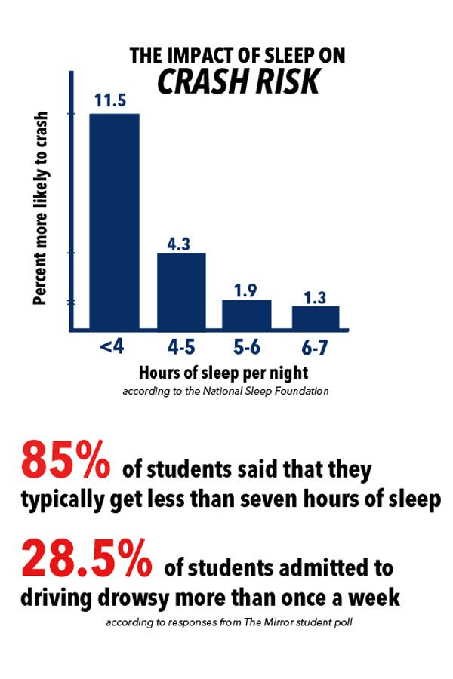
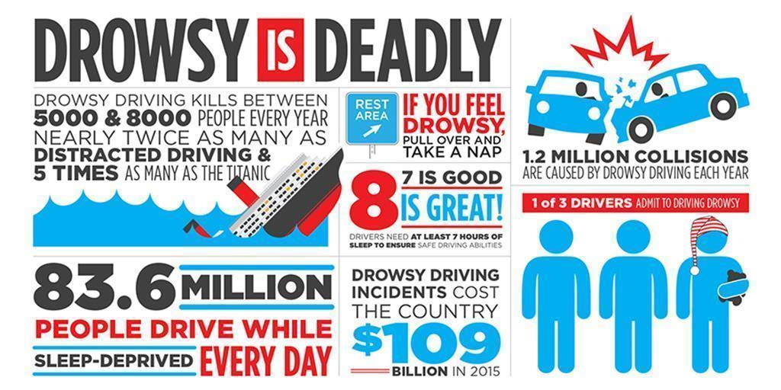

Slide 6
How can we solve this problem?
We can detect the driver’s drowsiness using a system which use machine learning integrated with image processing.
Machine Learning – The next big thing in
tech and automation industry:
Machine learning (ML) is a category of algorithm that allows
software applications to become more accurate in predicting
outcomes without being explicitly programmed.
The basic premise of machine learning is to build algorithms that can
receive input data and use statistical analysis to predict an output
while updating outputs as new data becomes available.

Slide 7
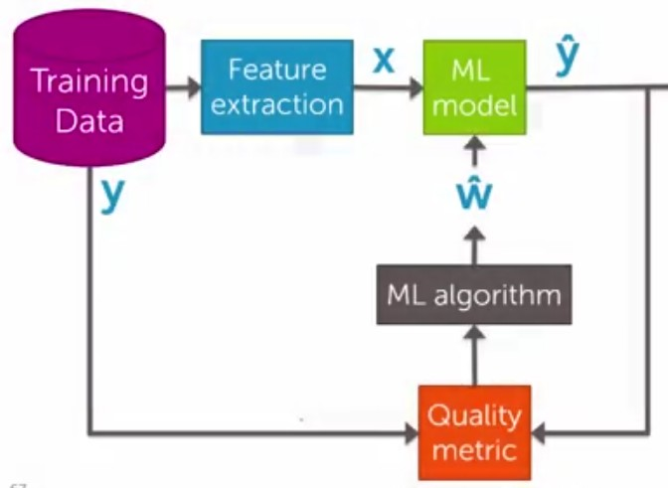

Slide 8
Technique we have used to solve the problem
Real Time Drowsiness behaviors which are related to fatigue are in the form of eye closing, yawn detection etc.
The technique is to measure physical changes (i.e. open/closed eyes to detect fatigue) is well suited for real world conditions since it is non-intrusive by using a video camera to detect changes

Slide 9
For Face Detection we use:
For the face Detection we have used Dlib’s model.
The author of the Dlib library has trained two shape predictor models that respectively localize 68 and 5 landmark points within a face image.
In this project, we have used only the shape_predictor_68 model.

Slide 10
In the system we have used facial landmark prediction for eye detection facial landmarks are used to localize and represent salient regions of the face, such as:
Eyes
Eyebrows
Nose
Mouth
Jawline

Slide 11
For every video frame, the eye landmarks are detected. The eye aspect ratio (EAR) between height and width of the eye is computed.
EAR =||p2 − p6|| + ||p3− p5||
2||p1 −p4||
Where p1,...,p6 are the 2D landmark locations , depicted . The EAR is mostly wherep1,...,p6 are the 2D landmark locations , depicted .

Slide 12
If the eye is closed, the eye aspect ratio will again remain approximately constant, but will be much smaller than the ratio when the eye is open.
The last step of the algorithm is to determine the person’s condition based on a pre-set condition for drowsiness. The average blink duration of a person is 100-400 milliseconds (i.e. 0.1-0.4 of a second). Hence if a person is drowsy his eye closure must be beyond this interval. We set a particular time frame. If the eyes remain closed for this time, drowsiness is detected and alert alarm regarding this is triggered.

Slide 13
Finally, the decision for the eye state is made based on EAR calculated in the previous step. If the distance is zero or is close to zero, the eye state is classified as “closed” otherwise the eye state is identified as “open”.

Slide 14
Future Scope
This project can be implemented in the form of mobile application to reduce the cost of hardware.
This project can be integrated with car, so that automatic speed control can be imparted if the driver is found sleeping.
Rather using alarm we can use Automatic Braking System which will reduce the speed of the vehicle.

Slide 15
Future Scope Cont...
The vehicle can be automatically parked by first using Automatic braking system, which will reduce the speed and concurrently will turn on the parking lights of the vehicle
Using Pressure sensor on the steering alarm or Automatic braking System can be set in case of drowsiness. By using wireless Technology if the driver gets drowsy an alert message can be sent to a selected person’s mobile by using GSM module along with the alarm in vehicle.

Slide 16
Thank you

